Slide 1
Trends in Programming Paradigms
Programming Paradigms

Slide 2
PROGRAMMING PARADIGMS
A programming paradigm is a general approach to programming or to the solution of problems using a programming language.
Can also be seen as:
  A way of thinking about programming
  view of a program
VCN 9691 COMPUTING

Slide 3
Introduction
One approach to study computer programming is to study programming languages.
  But there are a tremendously large number of languages, so large that it is impractical to study them all.
How can we tackle this immensity?
  We could pick a small number of languages that are representative of different programming paradigms.
  But this gives little insight into programming as a unified discipline.
We focus on programming concepts and the techniques to use them, not on programming languages.

Slide 4
Introduction
The concepts are organized in terms of computation models.
  A computation model is a formal system that defines how computations are done.
  There are many ways to define computation models.
  It is important that the computation model should be directly useful to the programmer.
Each computation model has its own set of techniques for programming and reasoning about programs.
The number of different computation models that are known to be useful which is much smaller than the number of programming languages.

Slide 5
Introduction
Computer science defines computation model in terms of concepts that are important to programmers: data types, operations, and a programming language.
  The term ‘computation model’ makes precise the imprecise notion of ‘programming paradigm’.
Sometimes we will use the phrase programming model.
  This refers to what the programmer needs: the programming techniques and design principles made possible by the computation model.

Slide 6
Introduction
Each computation model is based on a simple core language called its kernel language.
  Computer science books introduce the kernel languages in a progressive way, by adding concepts one by one.
    This helps us to show the deep relationships between the different models.
  Often, just adding one new concept makes a world of difference in programming.
When stepping from one model to the next, how do we decide on what concepts to add?
  The main criterium is the creative extension principle.
  Roughly, a new concept is added when programs become complicated for technical reasons unrelated to the problem being solved.
  Adding a concept to the kernel language can keep programs simple, if the concept is chosen carefully.
Notes:
For example, adding destructive assignment (explicit state) to functional programming allows us to do object-oriented programming.

Slide 7
Software paradigms: #1 Myths
The Programmer can choose the "one true paradigm" for a project in isolation from other factors.
  Reality: programming is now a social activity in which the "one true path" is a meaningless concept.
Religious wars:
  Proponents of one paradigm often engage in holy wars.
    Functional versus imperative programming.
    Strong versus weak typing.
    Speed versus robustness.
    Memory models.
    High-level versus low-level programming.
  We must be careful not to descend into this pit.

Slide 8
Software paradigms: #1 Myth
The proper paradigm is not an absolute; it depends upon:
  The social context of each paradigm
    (technological) Footprint:
      How many people use it?
      Has it been used successfully in similar cases?
      How many people know how to use it?
    (software) Legacy:
      What has been used before?
      What lessons were learned?
      What should we do differently?
      Why should we do it differently?
    (technological) Infrastructure:
      What pre-existing resources are there?
      What new resources are required?
      How much will they cost?
      Can we afford it?

Slide 9
Software paradigms: #2 Myth
“There is a programming paradigm appropriate to solve all programming problems.”
  Reality: paradigms evolve in order to address specific cases, not the general case.
Programmers do not survive by "being the fittest"; they survive by "fitting in" and by getting the job done.
  Likewise, paradigms do not survive by "being the fittest“; they survive by fitting into the larger context of software development.
A basic and fundamental paradigm shift
  From "survival of the fittest": the programmer is a self-sufficient island.
  To "survival of those who fit": the programmer is a connected and active citizen of a culture of learning all paradigms for use.
Notes:
How to fit:
Share your expertise and experience.
View that sharing not as fact, but associal evidence.
Become an intelligent consumer of evidence.

Slide 10
Software paradigms: #3 Myth
“One should always choose the most recent paradigm; it will be the easiest to use. “
  Reality: the choice is also based upon other factors, including frequency of adoption and social pressure.
"The Magic Show"
  The internet is full of videos that claim that "you can become a <insert paradigm> programmer in 15 minutes.“
  This makes good PR, but is incredibly misleading.
    As long as you follow the steps, you will get the same result.
    But if you deviate - in any respect - you are likely to accomplish nothing at all.
    These videos are rituals.
  So, rituals are useful only as long as all you need to write is a guestbook!

Slide 11
Software paradigms: #4 Myth
“If I have a great idea, I can become the next Bill Gates/Steve Jobs/...”
  Reality: It is about as likely as winning the lottery.
    If you have a great idea, you can rest assured that at least 1000 other people had the same idea.
    The difference is whether you do something about it, and whether you're first to market with the innovation.
Notes:
We're all swimming in the same river.

Slide 12
Paradigm adoption
Social guidelines for paradigm adoption
Learning the language might be something that has to be done
  Consider the downsides of adoption
    There is nothing more difficult than swimming against a social river.
  Consider success and failure stories as evidence, and not as truth.
  Remember the differences between pattern and ritual.
  Seek to function via chemistry rather than alchemy.
  Use the law of the median to your advantage, rather than to your disadvantage.
    Avoid superfluous divergence from the median use case.

Slide 13
What is programming?
Programming is the step between the system’s specification and a running program that implements it.
  The step consists of designing the program’s architecture and abstractions and coding them into a programming language.
  This is a broad view, perhaps broader than the usual connotation attached to the word programming.
    It covers both programming “in the small” and “in the large” aspects.
    It covers both (language-independent) architectural issues and (language-dependent) coding issues.
    It is based more on concepts and their use rather than on any one programming language.
Notes:
This general view is natural for teaching programming.
It allows to look at many issues in a way unbiased by limitations of any particular language or design methodology.
When used in a specific situation, the general view is adapted to the tools used, taking account their abilities and limitations.

Slide 14
What is programming?
Many authors define programming, as a general human activity, to mean the act of extending or changing a system’s functionality.
  Programming is a widespread activity that is done both by non-specialists and specialists (computer programmers).
Programming as defined above has two essential parts: a technology and its scientific foundation.
  The technology consists of tools, practical techniques, and standards, allowing us to do programming.
  The science consists of a broad and deep theory with predictive power, allowing us to understand programming to solve a problem.
Notes:
Ideally, the science should explain the technology in a way that is as direct and useful as possible.

Slide 15
What is programming?
If either part is left out, we are no longer doing programming.
  Without the technology, we are doing pure mathematics.
  Without the science, we are doing a craft, i.e., we lack deep understanding.
Teaching programming correctly therefore means teaching both the technology (current tools) and the science (fundamental concepts).
  Knowing the tools prepares the student for the present.
  Knowing the concepts prepares the student for future developments.

Slide 16
Programming languages
A programming language is a system of signs used to communicate a task/algorithm to a computer, causing the task to be performed and solved.
  Most computer languages are designed to facilitate certain operations and not others: numerical computation, or text manipulation, or I/O.
At the heart of it all is a fundamental question:
  What does it mean to understand a programming language?
  What do we need to know to program in a language?
There are three crucial components to any language.
  Language paradigm
  Syntax
  Semantics

Slide 17
Programming languages
The language paradigm is a general principles that are used by a programmer to communicate a task/algorithm to a computer.
The syntax of the language is a way of specifying what is legal in the phrase structure of the language.
  Knowing the syntax is analogous to knowing how to spell and form sentences in a natural language like English.
  However, this doesn’t tell us anything about what the sentences mean.
The semantics of a program in that language is the third component.
  Ultimately, without a semantics, a programming language is just a collection of meaningless phrases;
  Hence, the semantics is the crucial part of a language.

Slide 18
Programming education approaches
Pedagogical approach

Slide 19
Programming education approaches
How can we separate the languages’ fundamental concepts, which underlie their success, from their historical accidents?
  Practical programming languages provide a rich set of abstractions and syntax.
  They scale up to programs of millions of lines of code that have to be defined.
Four main approaches
  Kernel language
  Foundational calculus
  Virtual machine
  Multiparadigm language

Slide 20
Programming education approaches
Kernel language approach
  In this approach, a practical language is translated into a kernel language that consists of a small number of programmer-significant elements.
  The rich set of abstractions and syntax is encoded into the small kernel language.
    This gives both programmer and student a clear insight into what the language does.
  The kernel language has a simple formal semantics that allows reasoning about program correctness and complexity.
    This gives a solid foundation to the programmer’s intuition and the programming techniques built on top of it.

Slide 21
Programming education approaches
Foundational calculus approach
  A foundational calculus reduces programming to a minimal number of elements.
    The elements are chosen to simplify mathematical analysis, not to aid programmer intuition.
  This helps theoreticians, but is not particularly useful to practicing programmers.
    Foundational calculi are useful for studying the fundamental properties and limits of programming a computer, not for writing or reasoning about general applications but for showing how to write computer algorithms.
  Examples: λ-calculus or π-calculus

Slide 22
Programming education approaches
Virtual machine approach
  A virtual machine defines a language in terms of an implementation on an idealized machine.
  A virtual machine gives a kind of operational semantics, with concepts that are close to hardware.
    This is useful for designing computers, implementing languages, or doing simulations.
    It is not useful for reasoning about programs and their abstractions.

Slide 23
Programming education approaches
Multiparadigm language approach
  A multiparadigm language is a language that encompasses several programming paradigms.
  The usefulness of a multiparadigm language depends on how well the different paradigms are integrated.
  Examples:
    Scheme is both functional and imperative.
    Leda has elements that are functional, object-oriented, and logical.

Slide 24
Pedagogical approach
There are two complementary approaches to teaching programming as a rigorous discipline:
  The computation-based approach presents programming as a way to define executions on machines.
  The logic-based approach presents programming as a branch of mathematical logic.

Slide 25
Pedagogical approach
The computation-based approach presents programming as a way to define executions on machines.
  It grounds the student’s intuition in the real world by means of actual executions on real systems.
    This is especially effective with an interactive system: the student can create program fragments and immediately see what they do.
  Reduces the time between thinking “what if” and seeing the result which is an enormous aid to understanding.
    Precision is not sacrificed, since the formal semantics of a program can be given in terms of an abstract machine.

Slide 26
Pedagogical approach
The logic-based approach presents programming as a branch of mathematical logic.
  Logic does not speak of execution but of program properties, which is a higher level of abstraction.
  Programs are mathematical constructions that obey logical laws.
  The formal semantics of a program is given in terms of a mathematical logic.
    Reasoning is done with logical assertions.
  The logic-based approach is harder for students to grasp yet it is essential for defining precise specifications of what programs do.

Slide 27
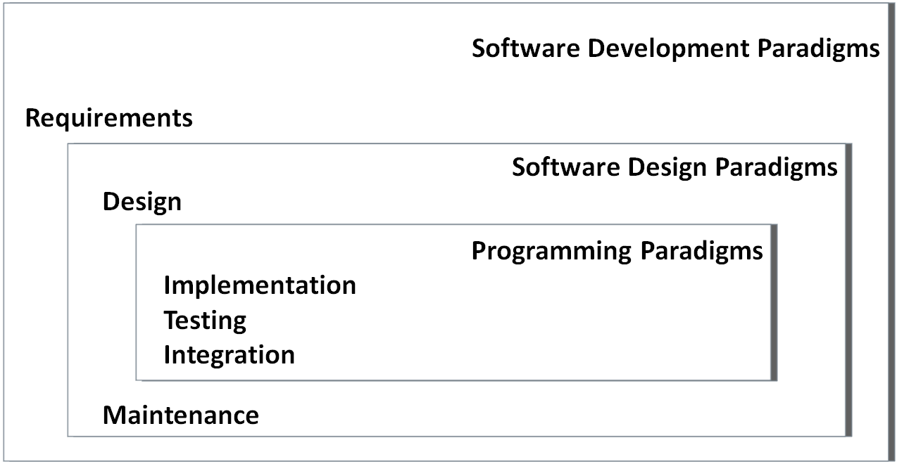
Software paradigms
Paradigm (a Greek word meaning example) is commonly used to refer to a category of entities that share a common characteristic.
Computer science distinguish three different kinds of software paradigms:
  Programming Paradigm:
    It is a model of how programmers communicate calculation to computers
  Software Design Paradigm:
    It is a model for implementing a group of applications sharing common properties
  Software Development Paradigm:
    It is often referred to as Software Engineering, may be seen as a management model for implementing big software projects using engineering principles.

Slide 28
PROGRAMMING PARADIGMS
A programming paradigm is a general approach to programming or to the solution of problems using a programming language.
Can also be seen as:
  A way of thinking about programming
  view of a program
VCN 9691 COMPUTING

Slide 29
Programming paradigm
Programming paradigm is a fundamental style of computer programming.
  Compare with a software development methodology, which is a style of solving specific software engineering problems.
Programming paradigm is a model for a class of programming languages that share a set of common characteristics.
  Some languages are designed to support one particular paradigm
    Smalltalk supports object-oriented programming
    Haskell supports functional programming
  Other programming languages support multiple paradigms
    Object Pascal, C++, C#, Visual Basic, Common Lisp, Scheme, Perl, Python, Ruby, Oz and F#.

Slide 30
Programming paradigms
Different methodologies are more suitable for solving certain kinds of problems or applications domains.
  Same for programming languages and paradigms.
  Multiparadigm languages allow programmers to use the best tool for a job, admitting that no one paradigm solves all problems in the easiest or most efficient way.
Programming paradigms differ in:
  the concepts and the abstractions used to represent the elements of a program (such as objects, functions, variables, constraints, etc.)
  the steps that compose a computation (assignation, evaluation, data flow, control flow, etc.).

Slide 31
Programming paradigms
There are just four major programming language paradigms:
  Imperative (Procedural) Paradigm
  Object-Oriented (OO) Paradigm
  Logic Paradigm
  Functional Paradigm
Examples:
  Imperative paradigm: Algol, Pascal, C, Ada;
  Functional paradigm: C, Lisp, Refal, Planner, Scheme;
  Logic paradigm: Prolog;
  Object-oriented paradigm: Python, Java, Smalltalk, Eiffel.
Markup - new major paradigm
  not a programming, but used to specify the layout of information in Web documents
  Examples: XHTML, XML

Slide 32
Programming Paradigms
Paradigm | Key concept | Program | Program execution | Result
Imperative | Command (instruction) | Sequence of commands | Execution of commands | Final state of computer memory
Functional | Function | Collection of functions | Evaluation of functions | Value of the main function
Logic | Predicate | Logic formulas: axioms and a theorem | Logic proving of the theorem | Failure or Success of proving
Object-oriented | Object | Collection of classes of objects | Exchange of messages between the objects | Final state of the objects’ states

Slide 33
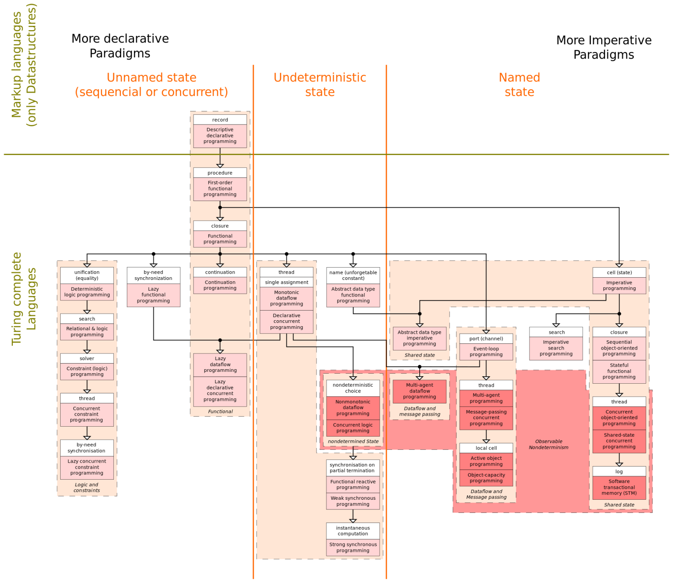

Slide 34
Programming paradigms
Imperative
  Von Neumann - Fortran, Pascal, Basic, C
  Scripting - Perl, Python, JavaScript, PHP
  Object-oriented - Smalltalk, Eiffel, C++
Declarative
  Functional - Scheme, ML, pure Lisp, FP
  Logic, constraint-based - Prolog, VisiCalc, RPG

Slide 35
Programming paradigms: Alternatives
Imperative(How the prog should do it)
  Procedural - C
    Block-Structured - Pascal, Ada
  Object-based - Ada
    Object-oriented - Object-Pascal, C++, Java
    Parallel Processing - Ada, Pascal-S, Occam, C-Linda
Declarative(what program should do at each level)
  Logic - Prolog
  Functional - LISP, Scheme
  Database - SQL

Slide 36
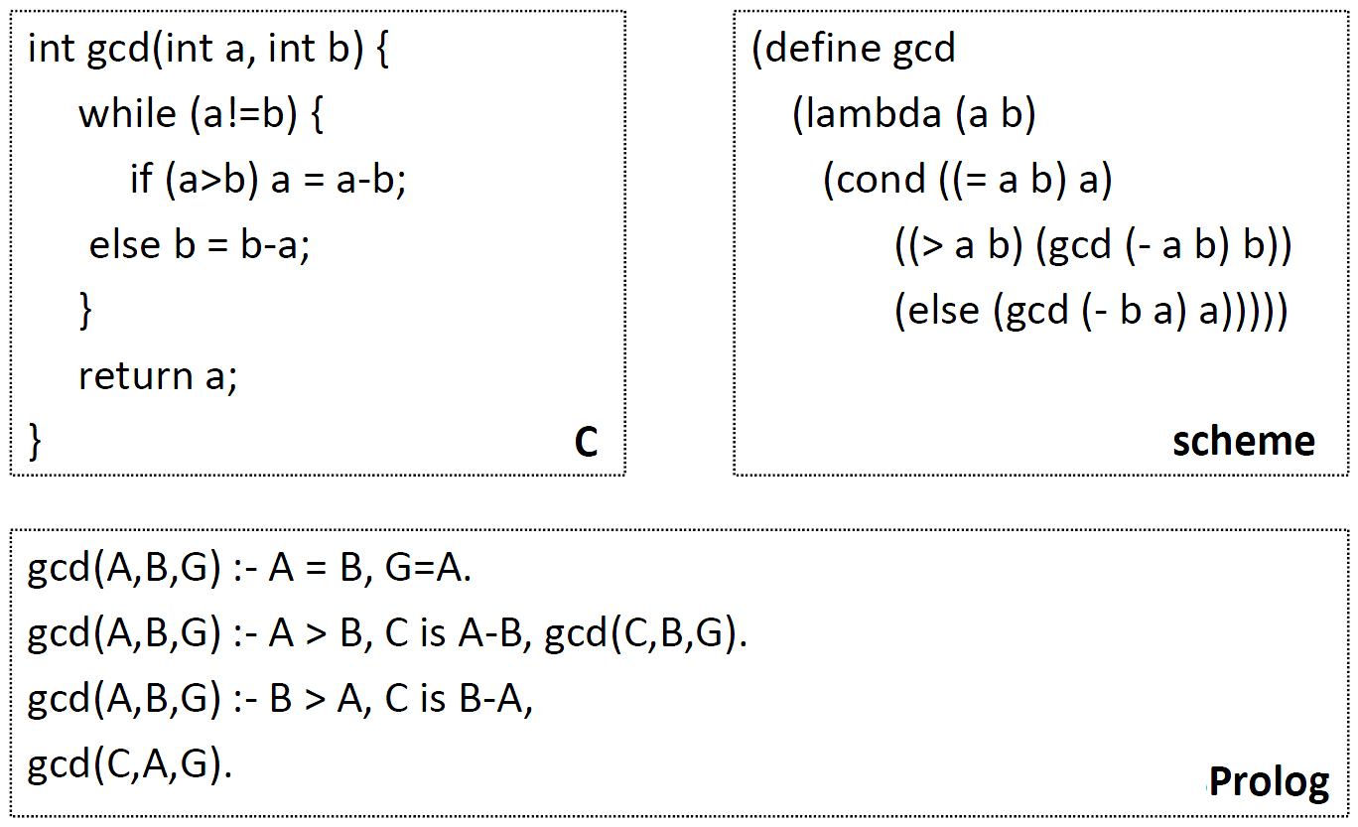
Programming paradigms
Examples

Slide 37
Programming paradigm
Examples of multiparadigm languages:
  Imperative + OO paradigms: C++, Object Pascal, Ada-95, Java;
  Functional + OO paradigms: Clos;
  Logic + OO paradigms: Object Prolog.
  Imperative + OO + Functional paradigms: Common Lisp.
Generally, a selected programming paradigm defines main property of a software developed by means of a programming language supporting the paradigm.
  scalability/modifiability
  integrability/reusability
  portability
  performance
  reliability
  ease of creation

Slide 38
Programming Paradigms
Imperative programming
Functional programming
Logic programming
Event-driven programming
Object-oriented programming
A programming language can use one or multiple styles

Slide 39
1. Imperative programming
Programs written in a sequence of instructions – the program is executed in order of the programmer designs
Fortran and Cobol are examples of imperative languages
Pascal, C and Ada also use the imperative model
Imperative programs work and are manipulated with variables and data structures (e.g. Arrays, records etc)

Slide 40
2. Logic Programming
Logic programming languages are made of sets of facts and rules
They are often used to develop AI type systems (e.g. ELIZA – the online therapist)
The best known language is Prolog – SWI-Prolog is a an example implementation

Slide 41
3. Event driven programming
Sub routines / functions / procedures are not executed in a specific order – but according to events that are triggered (usually by a user)
E.g. The print button in Word triggers a ‘click’ event which then runs the print procedure
Delphi, Visual Basic.Net and Python are all examples of languages that can use event driven programming

Slide 42
Event Driven Programming cont.
Event Trigger --> action which gets the program to execute your code e.g. click, mouse_move, etc
The event trigger --> runs a sub procedure / event sub procedures
The sender: control that triggered the event
The receiver: usually the event sub procedure. It is told to HANDLE the e.g. click event of the button --> the handler
Event arguments (eventargs): data that the sender passes to the event sub procedure, e.g. the key that you typed into a textbox

Slide 43
Event driven programming cont.
Uses objects (e.g. forms, buttons, textboxes) as the controls which trigger the events
Used to develop: programs that need GUIs, programs that need to be developed quickly (RAPID APPLICATION DEVELOPMENT), applications where the USER is the main focus
Usually developed using visual tools and techniques where the interface is developed separately from the code
Event driven programs can be prototyped very quickly
Often event driven languages have built in wizards/functionality to access advanced facilities quickly (databases, web browsers, drop down menus)
You can add components to your event driven language (e.g. a media player, an RSS reader control)

Slide 44
4. DECLARATIVE PROGRAMMING PARADIGMS
In this paradigm, the computer is told what the problem is but it doesn’t have the steps necessary to solve the problem.
A program written in a declarative language searches a database according to a set of rules supplied to it and produces the results.
An example of a declarative programming language is Prolog.
VCN 9691 COMPUTING

Slide 45
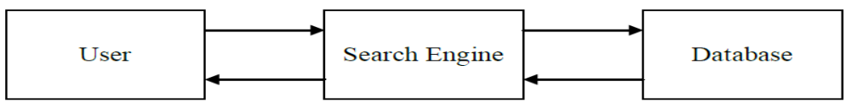
Declarative Programming
Declarative languages tell the computer what is wanted but do not provide the details of how to do it
The system simply consists of a search engine and a database of facts and rules.
There are no IF, WHILE, FOR, etc statements.

Slide 46
Declarative programming - Example
For example, using Prolog, suppose the database is
    female(jane).
    female(anne).
    female(sandip).
    male(charnjit).
    male(jaz).
    male(tom).
The query male(X) will return
    X = charnjit
    X = jaz
    X = tom
    Notice that the user does not have to tell Prolog how to search for the values of X that satisfy the query.

Slide 47
5. PROCEDURAL PARADIGM
These are problem-oriented. i.e. they use terms that are specific to the problem being solved.
The instructions used are English-like, which makes it easy for the programmer to write code.
Examples
  COBOL (Common Business Oriented Language)
  FORTRAN (Formula Translation)
  ALGOL (Algorithmic Language)
  BASIC (Beginners’ All-purpose Symbolic Instruction Code)
  C(Computer Programming)
The disadvantage is that it can be difficult to reuse code and to modify solutions when better methods of solution are developed.
VCN 9691 COMPUTING

Slide 48
PROGRAMMING PARADIGMS AND EXAMPLES
PROCEDURAL LANGUAGES
Procedural languages specify, exactly, the steps required to solve a problem.
Each line of code is executed one after the other in sequence.
The programmer has to specify exactly what the computer is to do.
They use sequence, selection and repetition constructs
  IF / ELSE, CASE or SWITCH,
  FOR ... NEXT,REPEAT ... UNTIL ..., WHILE ... DO ...
VCN 9691 COMPUTING

Slide 49
Procedural Programming - Example
This is a C procedural program that finds the area of a rectangle:

Slide 50
Procedural programming - Example
The IF /ELSE and CASE or SWITCH constructs are used for selection
The FOR..NEXT, WHILE…, DO..WHILE.., and REPEAT..UNTIL are all used for iteration.
E.g.
    //Checking if a number is positive or negative in C++
    If(Number > 0)
    cout << "The number is positive.";
    ELSE
    {
    IF (Number = = 0)
    cout << "The number is zero.";
    ELSE
    cout << "The number is negative.";
    }

Slide 51
6. Functional Programming
Functional languages programs define mathematical functions
There are NO variables or assignment statements
Functional languages provide MODELS of mathematical functions
The classic example is HASKELL and the factorial algorithm

Slide 52
Functional cont.
5! (5 factorial) = 5 * 4 * 3 * 2 * 1
In Haskell this looks like:
  Let fac n = if n == 0 then 1 else n * fac (n-1)
  This looks nasty but what it does:
    Let fac n = ...create a function called fac (based on input n)
    If n == 0 then... If n is 0 then
    1 ... Return n = 1
    Else n * fac (n-1) ... Otherwise return n * fac (n-1). Fac(n-1) actually calls the function fac again – but this time with n – 1
  So what happens if you input: fac 5 ?
    Is n == 0? No – go to the else condition
    5 * fac (5-1) – call fac 4
      Is n == 0? No – go to the else condition
      4 * fac (4-1) – call fac 3
        Is n == 3? No – go to the else condition
        3 * fac (3 – 1) – call fac 2
    So we’ll end up with: 5 * (5-1) * (4-1) * (3-1) * (2-1) * (1-1) * 1 (because n==0)
    The 1 finishes the algorithm because it doesn’t call itself anymore
  An algorithm that calls itself is known as a recursive algorithm and we’ll look at them in more detail later on

Slide 53
7. Structured or Step-wise (Top-down) Programming
This is where a complex problem is broken down into smaller and smaller sub-problems until all the sub-problems can be solved easily.
Take an example of calculating wages of a person paid per hour. You could use the following steps.
Wages
Get Number of hours
Calculate Gross pay
Calculate deductions
Calculate net pay
Output wage slip
Calculate normal wages
Calculate overtime
Calculate taxes
Calculate others

Slide 54
Structured programming (cont)
We can turn this design into a series of functions and procedures. Lets call our program “Wages”
We shall have the following functions and procedures
    Wages()
    GetHours( ) returns an integer in range 0 to 60
    CalculateWages(Hours) returns gross wage
    CalculateNormalWages(Hours) returns wage for up to 40 hours
    CalculateOvertime(Hours) returns pay for any hours over 40
    CalculateDeductions(GrossWage) returns total deductions
    CalculateTax(GrossWage) returns tax due
    CalculateOthers(GrossWage) returns other deductions due
    CalculateNetWage(GrossWage, Deductions) returns net wage after deductions
    Procedure OutputResults(Hours, GrossWage, Tax, Others, Deductions, NetWage) Procedure to print the wage slip

Slide 55
Structured programming (cont)
A function or procedure is a sub-program that exists to perform a specific, single task.
We can use a function if a single value is returned. If no value or more than one value is being returned we use a procedure.
Note:
If you are programming in C, C++ or Java, there are ONLY functions and no procedures.
You also must indicate what data type the function shall return..
If a function is not going to return a value, its return type is void. That is, no value is actually returned.

Slide 56
Structured programming (cont)
The use of procedures and functions can assist a programming team when a piece of software is being developed in the following ways
  Individual expertise of each programmer can be utilized
  Errors are far more easily spotted
  Each procedure or function is much simpler to solve than the original problem
  Individual procedures are easier to test than the whole solution
  Library routines can be utilized
  One procedure can be used multiple times
  Functions are mathematically provable to be correct/faulty

Slide 57
8. OBJECT-ORIENTED PARADIGM
In these languages data, and methods of manipulating the data, are kept as a single unit called an object.
Object-orientated programs make use of classes.
A class is a template for creating objects.
Classes include reusable code.
A class has the three features
  data encapsulation,
    (hiding the internal implementation details of an object from its external view )
  Inheritance
    (when a child class is derived from the parent class, the child class would contain all the properties (attributes) and methods (operations) of the parent class )
  polymorphism.
    (when two or more classes that are inherited from a parent class, implementing an inherited method differently )
Examples of object-orientated programming languages: JAVA, Smalltalk, Eiffel, Etc
VCN 9691 COMPUTING

Slide 58
Object Oriented Programming (OOP)
OOP is built around the idea of OBJECTS built around the parameters of a CLASS
E.g. in the real world, CAR would be a Class we could call upon to build an object that had 4 wheels, registration number, doors etc.
Each Class will have CONSTRUCTORS coded so the CLASS knows how to build an object when called.
Each Class will have METHODS which are used so any instance of a class can perform tasks such as outputting the details of an object

Slide 59
How to solve a problem in OOP
Identify objects involved in the problem
    Identify the capability (functionality) of the objects
    Identify the information (data) kept by the objects
Deduce classes from (1)
    Generalize the objects found to design the classes
Identify relationship between classes
    Use the "is-a" and "has-a" rules to help
    "is-a": Potential class hierarchy
    "has-a": Association between separate classes
Implement the classes in incremental fashion
    Implement method by method

Slide 60
Object oriented programming
Forget about computers for a moment
A class: car
Properties: colour, size, number of wheels
Methods: (things it can do) drive, accelerate, brake, crash (ok, not really)
How do you create a new car from the car class?
You instantiate it – or in English, you create a new car object
The new car object (banger) inherits all of the properties and methods of the car class – the process is called inheritance
Back to programming:
  There’s a class in VB called the button class
    What properties might it have?
    What methods might it have?
  When you create a new button object (btngo) you __________ it
  When you create btngo what does it get? What’s that called?

Slide 61
Object oriented programming cont.
Step 1: Name the class.
Step 2: Decide on the properties of the class.
Step 3: Declare properties as private.
Step 4: Declare the constructor of the class. A constructor is procedure that is automatically invoked when an object is first instantiated (created from the class). In VB this is done for you automatically – but not in most languages!
Step 5: Declare the methods (procedures and
functions).
Step 6: Write the code for your methods.

Slide 62
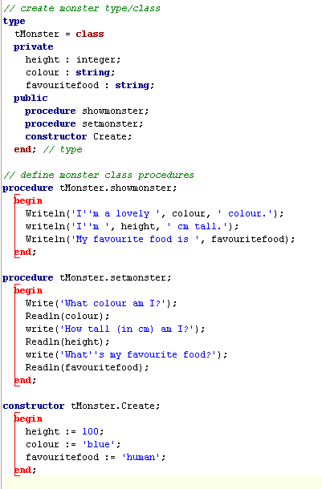
A basic OOP class in Pascal
Step 1: Create the class (As a type)
Step 2: Declare properties as
private.
Step 4: Create the public methods
(procedures and functions), including the constructor
Step 5: Create the class functions
and procedures

Slide 63
An example of OOP (in JAVA)
2
// sample of 2 classes , one is an application with a main method
// and the other is a simple class with 1 instance variable and 3 methods
// keep for future reference
package untitled14;
public class student
{
protected int age; /*also can make "private“*/
public student()
{
age=0;
}
public void setAge(int c)
{
age=c;
}
public int getAge()
{
return age;
}
}
package untitled14;
import java.io.*;
import javax.swing.*;
import java.awt.event.*;
import java.awt.*;
public class Application1
{
public static void main(String args[])
{
//how to create an object...
student shepherd = new student(); /*call to the constructor, creates the object*/
shepherd.setAge(30);
int p = shepherd.getAge();
JOptionPane.showMessageDialog(null,"Age is "+p);
//another option: "JOptionPane.showMessageDialog(null,"Age is "+shepherd.getAge());"
System.exit(0);
}
}
1

Slide 64

Summary Properties
Properties of a class are declared as private. This is so they cannot be accessed outside the class.
Methods (procedures and functions) are public and are written to enable the properties of the class to be accessed from outside the class.
A constructor is a special method that is used when a new object is created of that class. When an object is created it has all the methods and variables defined in the class.
Encapsulation is a term used to describe the combination of the object and its methods. This promotes separation of the implementation and the interface.
Because the properties of the class are private, you can control changes to the actual object. In addition, you have the flexibility to change the implementation without affecting anything outside the class. This principle is known as information hiding.
Inheritance is where one class can inherit methods and properties from another class. This promotes efficiency because code from one class can be reused in its sub-class.

Slide 65
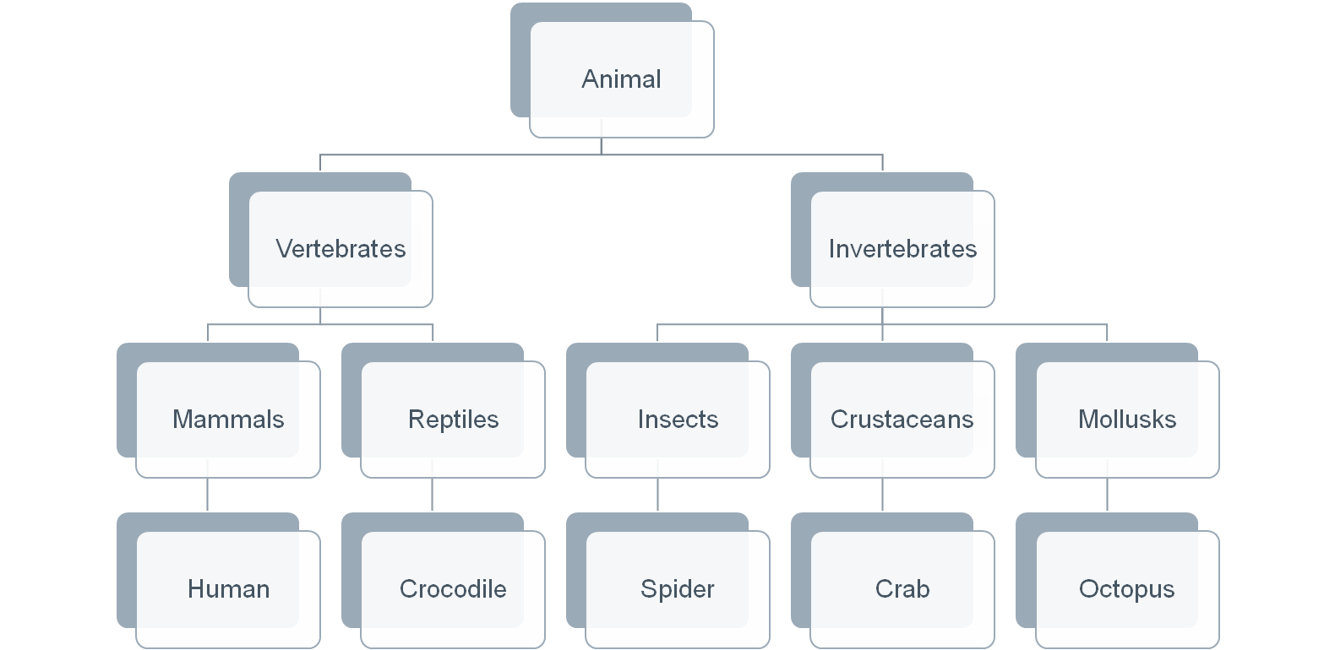
Inheritance Diagrams

Slide 66
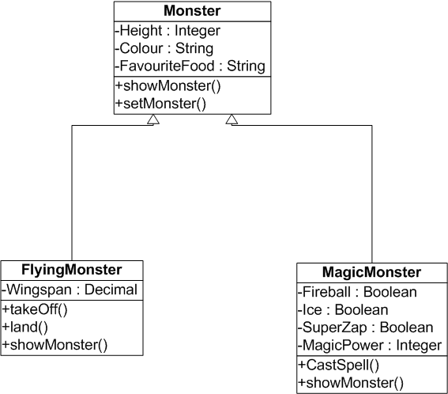
Class Diagram

Slide 67

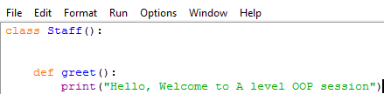
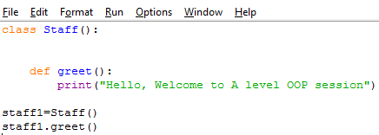
User Defined Classes and Objects
To define our own class we use the keyword class
Example1: Let us create a definition for Staff object
Step1: Create a class Staff
Step2: Let us define a method
greet () for this class
Outside Class:
Step3: Let us create an object from class Staff() (Instantiation)
Now run the program and see what happens
Notes:
Python will use our class Staff() to create a new instance of staff. staff1 is the variable used to make a reference to the first instance of class Staff(). Now we can use staff1 to call all methods defined in class Staff()

Slide 68
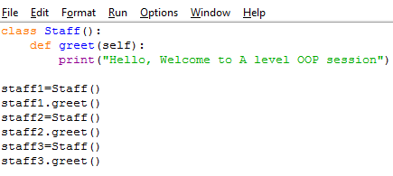
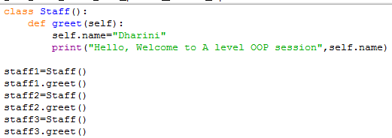
Multiple Instances
We would like to personalise the welcome message for different people
We can create multiple objects from the same class
Do you think this is an efficient method?

Slide 69
Session 3 Outline
To understand the inheritance relationship
Create and use inheritance
Examples Used:
  Person
  Students
  Teacher
  HOD

Slide 70
Recap: Classes and Objects
OOP attempts to simulate the real world by means of objects which have characteristics and functions
A class is a combination of variables, called attributes, and procedures, called methods, forming a self-contained programming entity
An object is one instance of the class definition.
The class definition is the blueprint or template that we use
Classes are accessed via their methods, not directly.
This means that OOP classes can be reused in many different programs without us needing to know how they work.

Slide 71

Class example : video
Properties (attributes)
Title
Year
Certificate
Genre
VideoID
HirePrice
Methods (procedures)
GetVideoDetails
UpdateHirePrice
SetGenre
Video

Slide 72

Object example : car
Properties
Make
Model
Mpg
Engine size
Year of reg
Mileage
Car Reg
Methods (procedures)
GetCarDetails
UpdateMileage
CalculateAge
Car

Slide 73
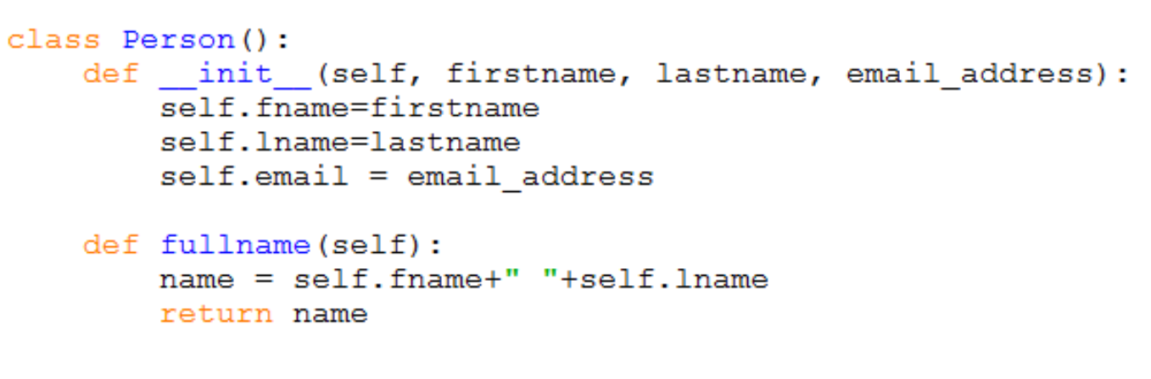
Person and Student class
Q: write the code to create an actual person called Cristiano Ronaldo with the email address cronaldo@gmail.com
A: person1 = Person(“Cristiano”, “Ronaldo”, cronaldo@gmail.com)

Slide 74
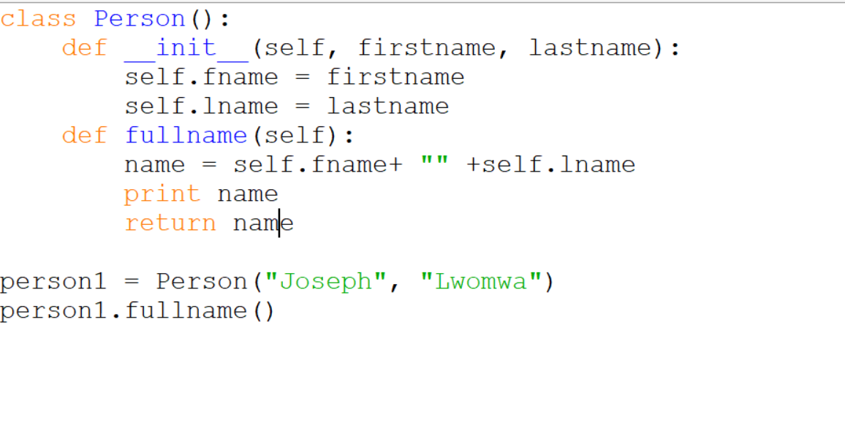

Slide 75
Designing abstractions
The most difficult work of programmers, and also the most rewarding, is not writing programs but rather designing abstractions.
Programming a computer is primarily designing and using abstractions to achieve new goals.
  Usually the same abstraction can be used to solve many different problems.
    This versatility is one of the key properties of abstractions.
    Designing abstractions is not always easy.
  Modern computers contain an enormous number of abstractions, working together in a highly organized manner.
Abstractions can be classified into a hierarchy depending on how specialized they are.
  Example: ‘pencil’ is more specialized than ‘writing instrument’, but both are abstractions.
Notes:
It can be a long and painful process, as different approaches are tried, discarded, and improved. But the rewards are very great. It is not too much of an exaggeration to say that civilization is built on successful abstractions

Slide 76
Abstraction and Modularization
Re-use, sharing, extension of code are critically important in software engineering
Big idea: detect errors at compile-time, not when program is executed
Type definitions and declarations
  Define intent for both functions/procedures and data
Abstract data types (ADT)
  Access to local data only via a well-defined interface
Lexical scope

Slide 77
TYPES OF LANGUAGES AND TYPICAL APPLICATIONS
1. LOW-LEVEL PROGRAMMING PARADIGM
Initially, computers were programmed using binary.
This was difficult and led to many errors that were difficult to find.
Programs written in binary are said to be written in machine code;
This is a very low-level programming paradigm.
VCN 9691 COMPUTING

Slide 78
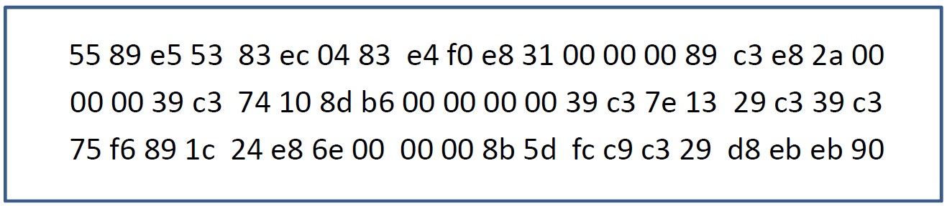
Brief history: Machine language
Machine language – the sequence of bits that directly controls a processor
  Add, compare, move data from one place to another, and so forth at appropriate times.
  Example: program in machine language for the x86 (Pentium) instruction set, expressed as hexadecimal numbers.

Slide 79
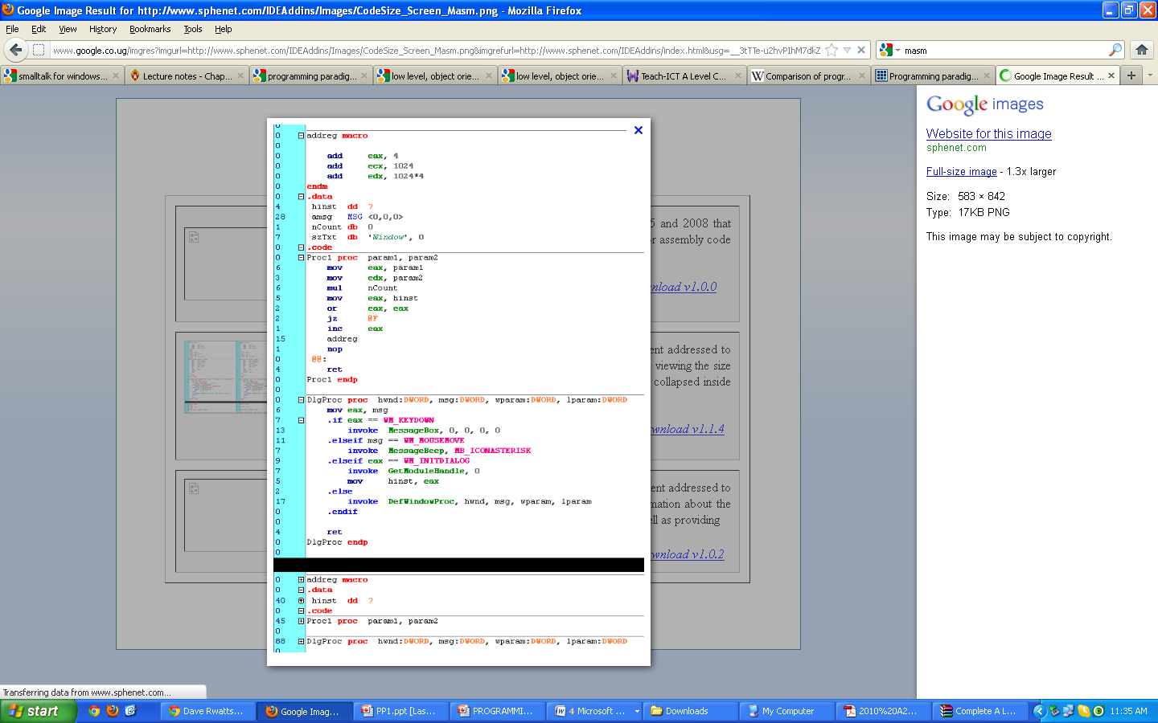
1. LOW-LEVEL PROGRAMMING PARADIGM (CONT)
To make programming easier, assembly languages were developed.
Binary functions are replaced by mnemonics
Memory addresses are replaced by labels.
Assembly language is hard to debug and is so prone to errors.
One example of an assembly programming language is MASM (Microsoft Assembler)
VCN 9691 COMPUTING

Slide 80
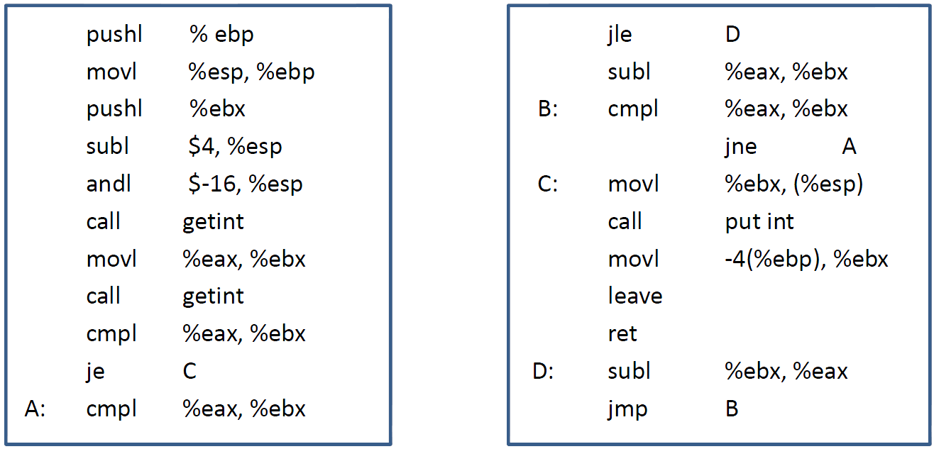
Brief history: Assembly language
Assembly language – expressed with mnemonic abbreviations, a less error-prone notation.
  One-to-one correspondence between mnemonics and machine language instructions
  Assembler – system program for translating from mnemonics to machine language
  Machine-dependent language – rewrite programs for every new machine
  Difficult to read and write large programs
  Example: program in assembly language for the x86

Slide 81
Brief history: High-level languages
Fortran – first high-level language in the mid-1950s
  Machine-independent language
  Compiler – system program for translating from high-level language to assembly or machine language
  Not one-to-one correspondence between source and target operations.
Other languages:
  Algol 60, COBOL (1959), PL/1 (1964), C (1959-1963), Pascal (1968-1969)
  LISP (1958), ML (1973)
  Prolog (1970)
  Smalltalk (1969-1972), C++ (1983), Java (1995)
  Modula 2(1978), Ada (1980)

Slide 82
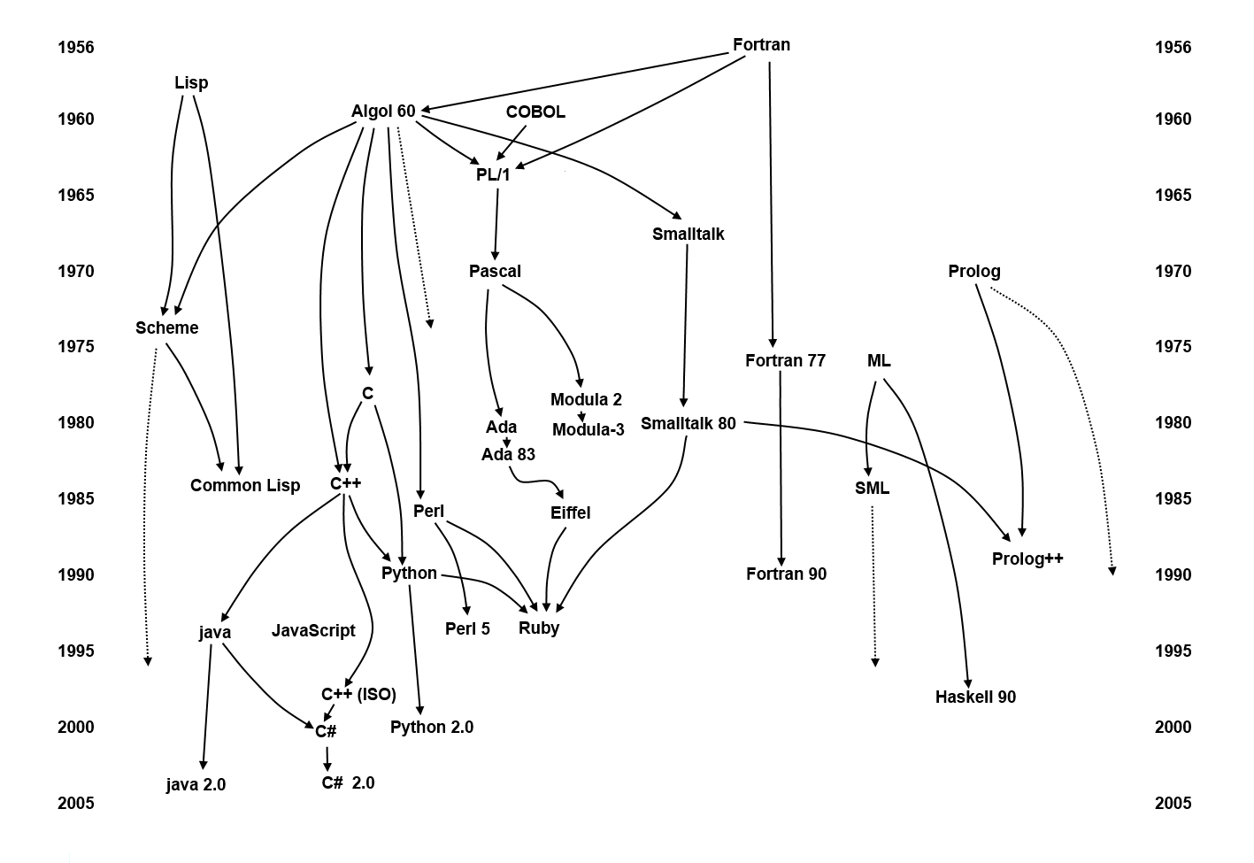
Brief history: High-level languages
Milestones

Slide 83
Why are there so many?
Evolution - learn better ways of doing things over time
  ‘goto’-based control flow (Fortran)
  structured programming (Pascal, C)
  object-oriented structure (C++, Java)
Special purpose
  symbolic data
  character strings
  low-level system programming
  reasoning, logical relation
Socio-economic factors:
  proprietary interests
  commercial advantage
Personal preference : diverse ideas about what is pleasant to use
Special hardware

Slide 84
Programming languages
A programming language is a system of signs used to communicate a task/algorithm to a computer, causing the task to be performed.
  Most computer languages are designed to facilitate certain operations and not others: numerical computation, or text manipulation, or I/O.
At the heart it all is a fundamental question:
  What does it mean to understand a programming language?
  What do we need to know to program in a language?
There are three crucial components to any language.
  Language paradigm
  Syntax
  Semantics

Slide 85
Programming languages
The language paradigm is a general principles that are used by a programmer to communicate a task/algorithm to a computer.
The syntax of the language is a way of specifying what is legal in the phrase structure of the language.
  Knowing the syntax is analogous to knowing how to spell and form sentences in a natural language like English.
  However, this doesn’t tell us anything about what the sentences mean.
The semantics of a program in that language is the third component.
  Ultimately, without a semantics, a programming language is just a collection of meaningless phrases;
  Hence, the semantics is the crucial part of a language.

Slide 86
Which programming language to use?
Since a task can be solved in different ways (paradigms), the language used to describe the solution differs in abstractions, structures due to the way in which the problem is solved.
  Choose among alternative ways to express things
    understand implementation costs
    based on knowledge of what will be done underneath
  Simulate useful features in languages that lack them.
  There is no theory that dictates the best paradigm to solve a particular problem.
How choose programming language?
  C vs. Modula-3 vs. C++ for systems programming
  Fortran vs. APL vs. Ada for numerical computations
  Ada vs. Modula-2 for embedded systems
  Common Lisp vs. Scheme vs. ML for symbolic data manipulation
  Java vs. C/CORBA for networked PC programs

Slide 87
What makes a language successful?
Expressive power
  Easy to express things, to use once fluent (C, APL, Algol-68, Perl)
Ease of use for novice
  Easy to learn (BASIC, Pascal, LOGO)
Ease of implementation
  BASIC, Forth
Standardization
  C, Java
Open source
  Wide dissemination without cost (Pascal, Java)
Excellent compilers
  Possible to compile to very good (fast/small) code (Fortran)
Patronage
  Backing of a powerful sponsor (COBOL, PL/1, Ada, Visual Basic)

Slide 88
Language evaluation criteria
Major criteria
  Readability: the ease with which programs can be read and understood
  Writability: the ease with which a language can be used to create programs
  Reliability: conformance to specifications (i.e., performs to its specifications under all conditions)
Others
  Cost: the ultimate total cost
  Portability: the ease with which programs can be moved from one implementation to another
  Generality: the applicability to a wide range of applications
  Well-definedness: the completeness and precision of the language’s official definition

Slide 89
Evaluation criteria: Readability
Overall simplicity
  A manageable set of features and constructs
  Few feature multiplicity (means of doing the same operation)
  Minimal operator overloading
Orthogonality
  A relatively small set of primitive constructs can be combined in a relatively small number of ways
  Every possible combination is legal
  Lack of orthogonality leads to exceptions to rules
  Makes the language easy to learn and read
  Meaning is context independent

Slide 90
Evaluation criteria: Readability
Control statements
  The presence of well-known control structures (e.g., while statement)
Data types and structures
  The presence of adequate facilities for defining data structures
Syntax considerations
  Identifier forms: flexible composition
  Special words and methods of forming compound statements
  Form and meaning: self- descriptive constructs, meaningful keywords

Slide 91
Evaluation criteria: Writability
Simplicity and orthogonality
  Few constructs, a small number of primitives, a small set of rules for combining them
Support for abstraction
  The ability to define and use complex structures or operations in ways that allow details to be ignored
Expressivity
  A set of relatively convenient ways of specifying operations
  Example: the inclusion of for statement in many modern languages

Slide 92
Evaluation criteria: Reliability
Type checking
  Testing for type errors
Exception handling
  Intercept run-time errors and take corrective measures
Aliasing
  Presence of two or more distinct referencing methods for the same memory location
Readability and writability
  A language that does not support “natural” ways of expressing an algorithm will necessarily use “unnatural” approaches, and hence reduced reliability

Slide 93
Evaluation criteria: Cost
Training programmers to use language
Writing programs
Compiling programs
Executing programs
Language implementation system: availability of free compilers
Reliability: poor reliability leads to high costs
Maintaining programs

Slide 94
Programming domains
Scientific applications
  Large number of floating point computations
  Language: Fortran
Business applications
  Produce reports, use decimal numbers and characters
  Language: COBOL
Artificial intelligence
  Symbols rather than numbers manipulated
  Language: LISP
Systems programming
  Need efficiency because of continuous use
  Language: C
Web Programming
  Eclectic collection of languages: markup (e.g., XHTML), scripting (e.g., PHP), general-purpose (e.g., Java)

Slide 95
Static vs. Dynamic Typing
Static typing
  Common in compiled languages, considered “safer”
  Type of each variable determined at compile-time
    Constrains the set of values it can hold at run-time
Dynamic typing
  Common in interpreted languages
  Types are associated with a variable at run-time; may change dynamically to conform to the type of the value currently referenced by the variable
  Type errors not detected until a piece of code is executed

Slide 96
Implementation methods
Compilation
  Programs are translated into machine language (e.g., Fortran, C, C++)
  Better performance
Pure Interpretation
  Programs are interpreted by another program known as an interpreter (e.g., Scheme, Haskell, Python …)
  Greater flexibility
  Better diagnostics (error messages)
Byte-code compiler
  Produces portable bytecode, which is executed on virtual machine (e.g., Java)

Slide 97
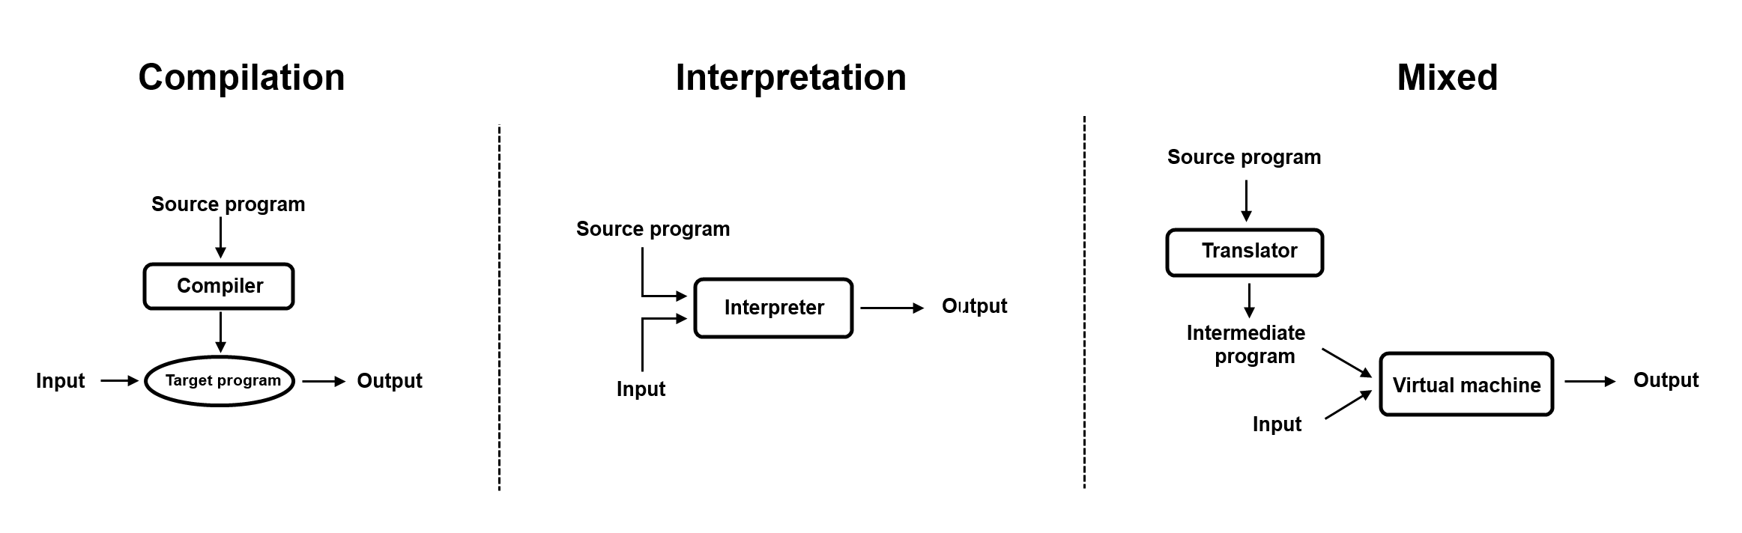
Implementation methods
Mixed (Hybrid) approaches
  Source-to-source translation (early C++ → C→compile)
  Just-in-time Java compilers convert bytecode into native machine code when first executed

Slide 98
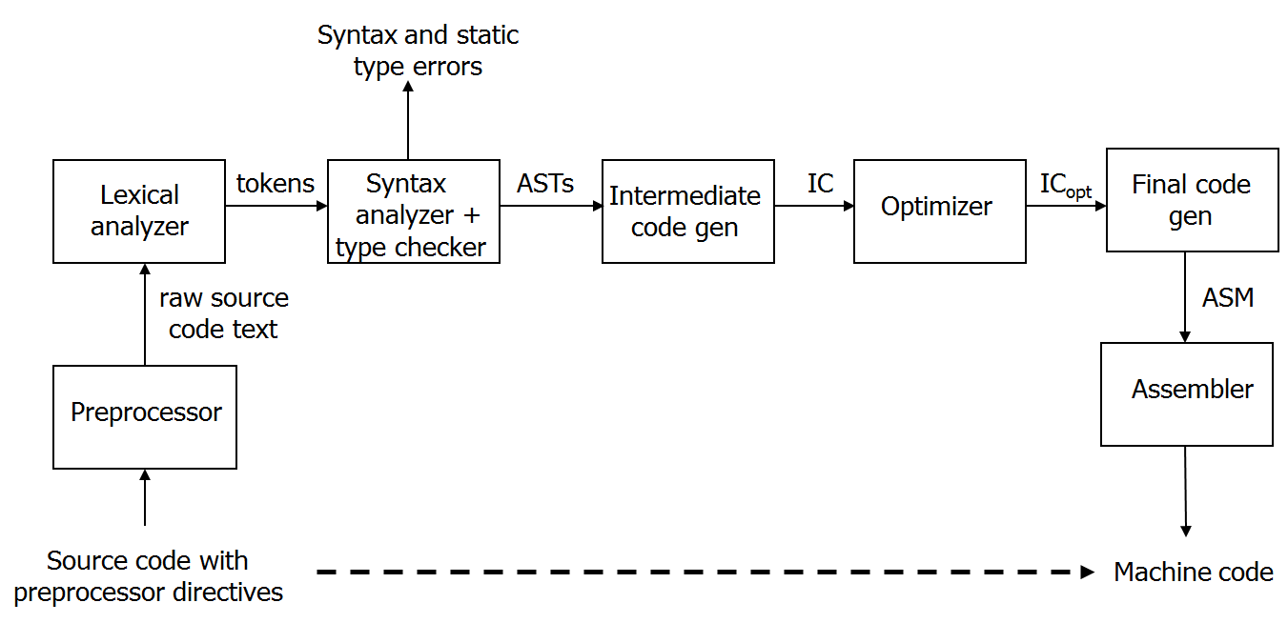
Compiler
Program that translates a source language into a target language
  Target language is often, but not always, the assembly language for a particular machine
Compilation process
Notes:
Preprocessing: conditional macro text substitution
Lexical analysis: convert keywords, identifiers, constants into a sequence of tokens
Syntactic analysis: check that token sequence is syntactically correct
Generate abstract syntax trees (AST), check types
Intermediate code generation: “walk” the ASTs and generate intermediate code
Apply optimizations to produce efficient code
Final code generation: produce machine code

Slide 99
Checks during compilation
Syntactically invalid constructs
Invalid type conversions
  A value is used in the “wrong” context, e.g., assigning a float to an int
Static determination of type information is also used to generate more efficient code
  Know what kind of values will be stored in a given memory region during program execution
Some programmer logic errors
  Can be subtle: if (a = b) … instead of if (a == b) …

Slide 100
Interpretation
‘Read-eval-print’ loop
  Read in an expression, translate into internal form
  Evaluate internal form
    This requires an abstract machine and a “run-time” component (usually a compiled program that runs on the native machine)
  Print the result of evaluation
  Loop back to read the next expression
input
expression
REPL
interpreter
result
Interpreter
runtime

Slide 101
Bytecode compilation
Combine compilation with interpretation
  Idea: remove inefficiencies of ‘read-eval-print’ loop
Bytecodes are conceptually similar to real machine opcodes, but they represent compiled instructions to a virtual machine instead of a real machine
  Source code statically compiled into a set of bytecodes
  Bytecode interpreter implements the virtual machine
Bytecode
compiler
Bytecode
interpreter
result
source
program
bytecodes
Virtual machine
runtime
Notes:
In what way are bytecodes “better” then real opcodes?

Slide 102
Questions ?

